Slide 1
The Sun Devil
Satellite Laboratory
Ricky Astrain
Mentor: Dr. Iman Alizadeh

Slide 2
Outline
The Sun Devil Satellite Laboratory Background
Attitude Determination & Control (ADCS) Test Bed
2014 AAS/ CanSat Competition
Sparky Sat
Vacuum Chamber
UAV Quad-copter
Future Plans

Slide 3
The Sun Devil Satellite Lab
Sun Devil Satellite Lab (SDSL) is a student organization registered with SORC at Arizona State University for its second year.
Mission: To design, test, build, and operate a variety of spacecraft technology.
Goals:
  Serve as a facilitator for engineering students to bring their ideas to reality
  Provide students with engineering and leadership experience
  Network with industry persons to prepare the next generation of aerospace engineers.
  Educate students specifically in satellite engineering technology
  Provide an environment for undergraduates to research real-world spacecraft engineering utilizing a systematic approach.

Slide 4
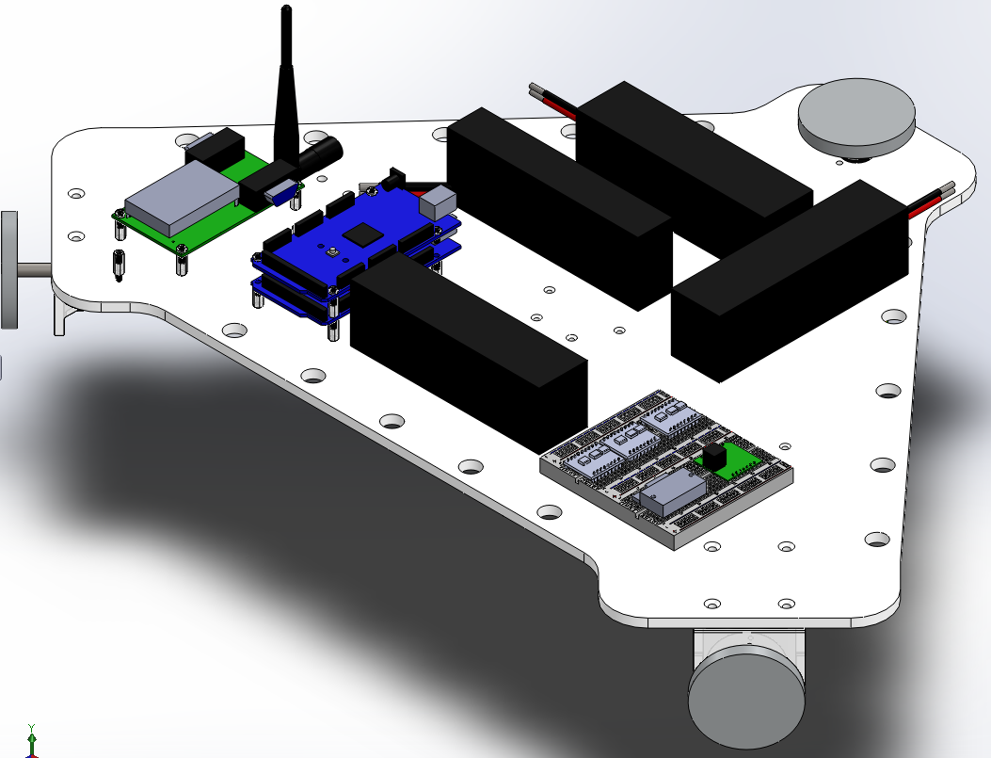
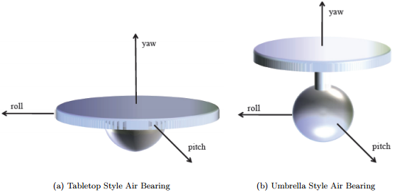
ADCS Test Bed
Goal: To provide a platform to test attitude determination/control for future CubeSat projects at ASU.
Method: Utilize tabletop style spherical air bearing test bed to provide frictionless, space-like, environment in 3 DOF.
Test Bed has self-contained 3-axis attitude determination and control to be used as a comparison for testing CubeSats.

Slide 5
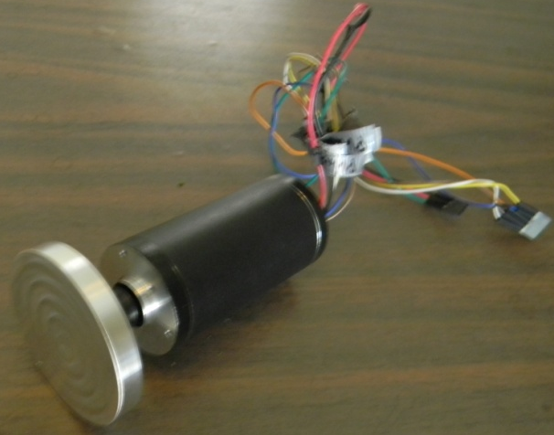
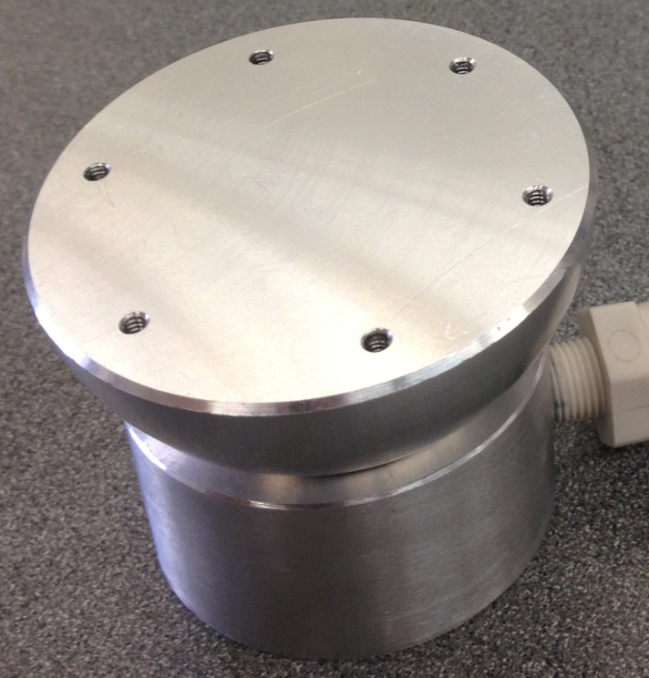
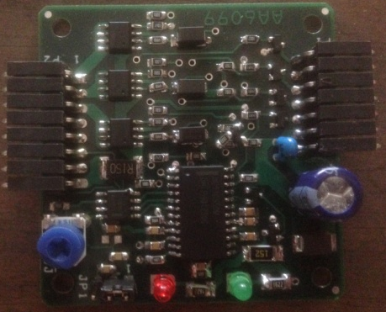
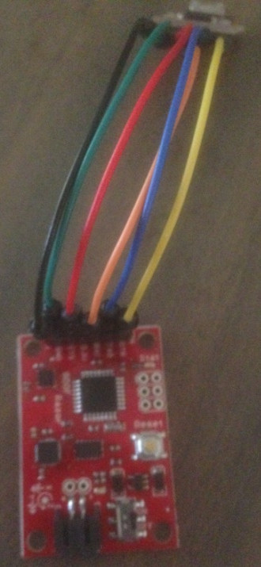
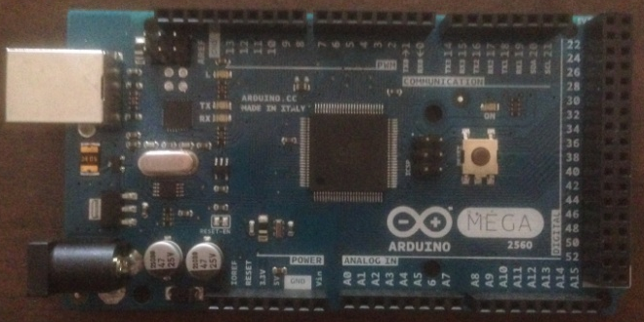
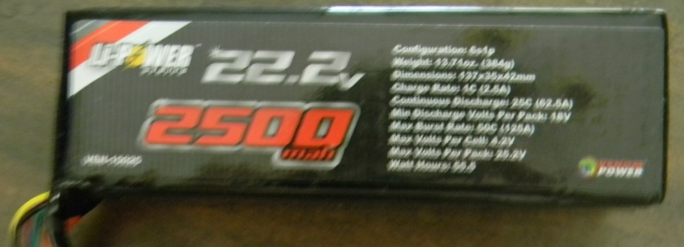
ADCS Test Bed
Reaction Wheel Assembly
Air – Bearing
Assembly
Motor Controller
IMU/Magnetometer
Arduino Mega (Microcontroller)
Battery

Slide 6
Annual CanSat Competition
Mission: Environmentally Powered Atmospheric Probe
Simulates delivering a sensor payload to an atmospheric planets surface
Other major requirements include:
  telemetry transmission
  autonomous operation
  descent control
  production of power from a non-battery source
  mid-flight separation of CanSat components
Competition reflects typical aerospace program design life-cycle including preliminary & critical design, and post-flight review presentations.
Currently 63 teams from 13 different countries are enrolled to participate in the competition.

Slide 7
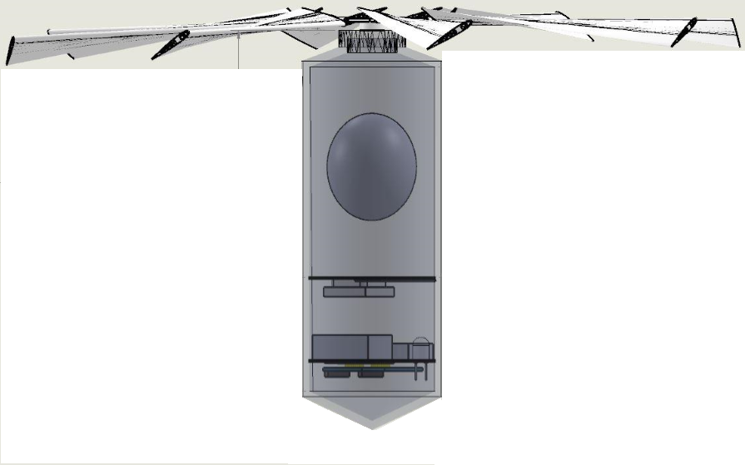
Sparky Sat
Servo will be used to detach “payload” from protective container at specified altitude
CanSat will utilize solar panels and 10F capacitors to provide power during flight
3-D printed structure will provide 10g acceleration resistance and 30g of shock resistance
Descent control system contains a self-deploying, auto-rotating structure to slow CanSat to ~10 m/s before ground impact.
Luminosity and infrared sensors will measure light intensity during descent
2nd place after PDR presentation
CDR has just been presented
Competition June 14th

Slide 8
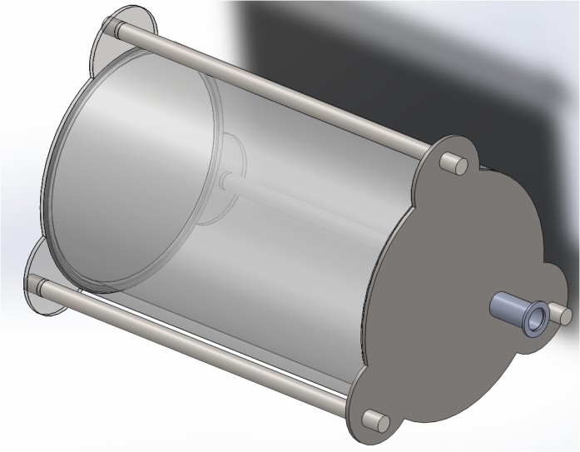
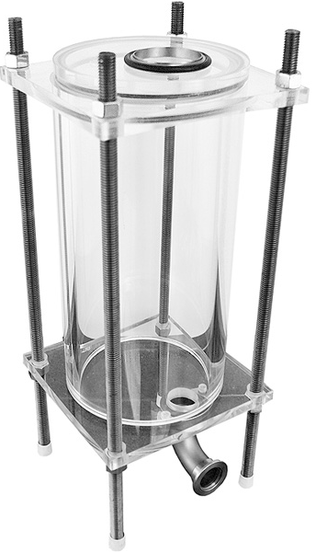
Vacuum Chamber
Organization members wanted to develop a pulsed plasma thruster but needed vacuum chamber to complete testing
Design specifically geared towards PPT testing
Vacuum chamber will be able to reach a pressure of 10⁻⁴ Pa
Testing volume is 10.5in x 18in
Fabrication of parts recently completed
Operational testing will be completed this week

Slide 9
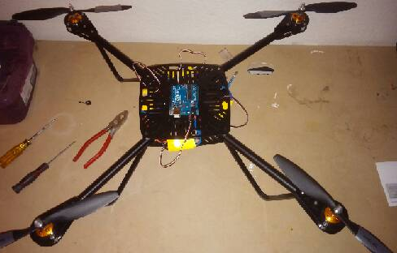
UAV Quad Copter
Being developed from the basic design of the Parallax ELEV-8 kit
End goal is to have ability to insert pre-made trajectories into quad copter
Attitude determination was developed from a ASU grad student who previously participated with SDSL
Motor controller algorithm is being developed and tested by SDSL members
It is planned next year to develop and integrate UAV guidance system

Slide 10
Future Plans
Continue to successfully submit teams to the annual AIAA CanSat Competition.
Continue to develop the ADCS Test Bed proof of concept prototype.
  Following successful proof of concept it is planned to use the same design for a more robust version
Develop a pulsed plasma thruster utilizing vacuum chamber for testing.
Finish motor controller and begin development of PID controller for UAV.
Submit a design to the NASA SmallSat Centennial Challenge
Gain further corporate sponsorship for organization and projects.

Slide 11
Acknowledgments
Special thanks to -
Project Mentors:
Dr. Iman Alizadeh
Anthony Grace
ASU Space Grant Staff:
Dr. Thomas Sharp
Candace Jackson
Michelle Tanaka
Stephanie Miller
SDSL Officers:
Jordan Bridgman
Alex Cannady
Bryan Sonneveldt
Sparky Sat Team:
Heather Zunino

